Slide 1

ING Hubs Turkiye
Hidden Affluent Business Case
01/2026
ING Hubs Turkiye/Analytics

Slide 2








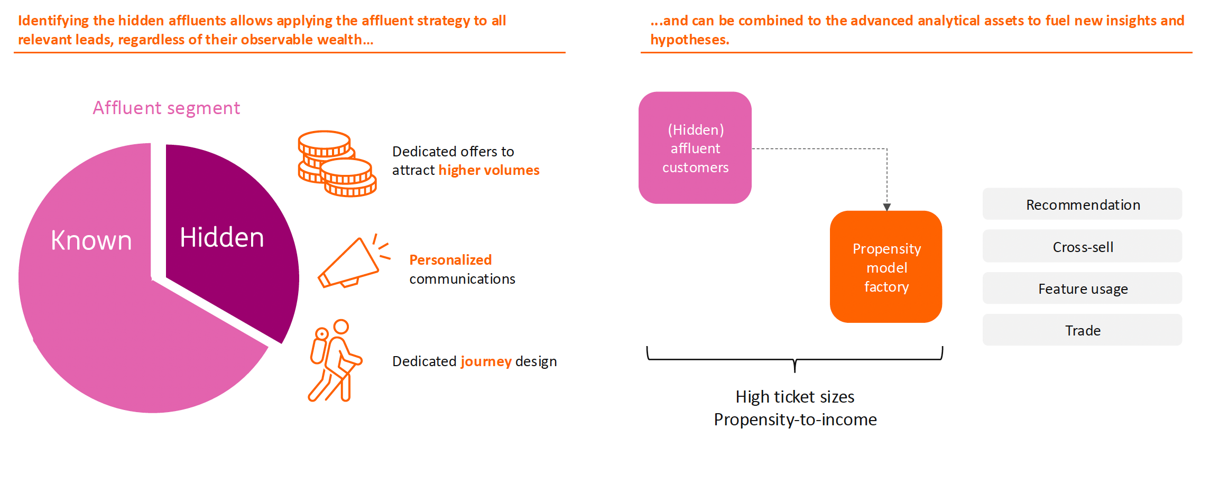
Timelines | completed
Hidden Affluent
Jan 2025 – December 2025
Description | Estimation of the clients who are likely to have some hidden value according to a predictive model trained on known high-value customers, & estimation of their ordinary hidden margin
Business Goals
Grow affluents by contributing to lead generation (increased conversion)
Increase fresh money inflow, prevent product cannibalization (grow fee and NII)
Provide targeted and better services to the customers
Metrics
Volume
Fresh
Money
Predicted Affluents
Conversion
Fee / NII

Slide 3
Thank you!

